Slide 1
Software Engineering
Sara Rehmat
MS (CS)

Slide 2
Behavioral Design Patterns
Behavioral design patterns are design patterns that identify common communication patterns between objects and realize these patterns. By doing so, these patterns increase flexibility in carrying out this communication.
Iterator Pattern
Observer Pattern

Slide 3
Iterator Pattern - Intent
Iterator is a behavioral design pattern that lets you traverse elements of a collection without exposing its underlying representation (list, stack, tree, etc.).

Slide 4
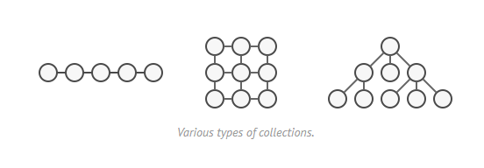
Iterator Pattern - Problem
Collections are one of the most used data types in programming. Nonetheless, a collection is just a container for a group of objects.

Slide 5
Iterator Pattern - Problem
Most collections store their elements in simple lists. However, some of them are based on stacks, trees, graphs and other complex data structures.
But no matter how a collection is structured, it must provide some way of accessing its elements so that other code can use these elements. There should be a way to go through each element of the collection without accessing the same elements over and over.
Traversal is easy in collection based on lists but different options exist for traversal in complex data structures like trees.
For example, one day you might be just fine with depth-first traversal of a tree. Yet the next day you might require breadth-first traversal. And the next week, you might need something else, like random access to the tree elements.

Slide 6
Iterator Pattern - Problem
Adding more and more traversal algorithms to the collection gradually blurs its primary responsibility, which is efficient data storage.
Additionally, some algorithms might be tailored for a specific application, so including them into a generic collection class would be weird.
On the other hand, the client code that’s supposed to work with various collections may not even care how they store their elements. However, since collections all provide different ways of accessing their elements, you have no option other than to couple your code to the specific collection classes.

Slide 7
Iterator Pattern - Solution
The main idea of the Iterator pattern is to extract the traversal behavior of a collection into a separate object called an iterator.
In addition to implementing the algorithm itself, an iterator object encapsulates all of the traversal details, such as the current position and how many elements are left till the end.
Because of this, several iterators can go through the same collection at the same time, independently of each other.
Usually, iterators provide one primary method for fetching elements of the collection. The client can keep running this method until it doesn’t return anything, which means that the iterator has traversed all of the elements.
All iterators must implement the same interface. This makes the client code compatible with any collection type or any traversal algorithm as long as there’s a proper iterator.
If you need a special way to traverse a collection, you just create a new iterator class, without having to change the collection or the client.

Slide 8
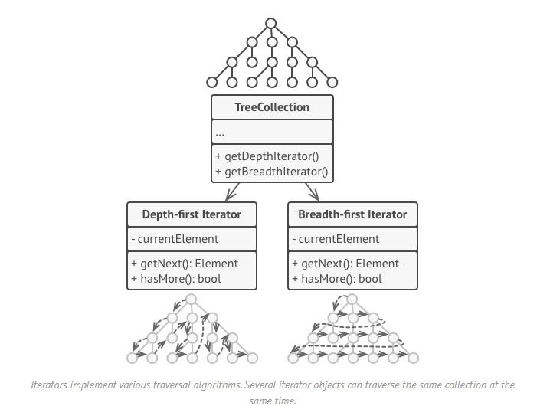
Iterator Pattern - Solution

Slide 9
Iterator Pattern – Real World Analogy
You plan to visit Rome for a few days and visit all of its main sights and attractions. But once there, you could waste a lot of time walking in circles.
On the other hand, you could buy a virtual guide app for your smartphone and use it for navigation. It’s smart and inexpensive, and you could be staying at some interesting places for as long as you want.
A third alternative is that you could spend some of the trip’s budget and hire a local guide who knows the city like the back of his hand.
All of these options—the random directions born in your head, the smartphone navigator or the human guide—act as iterators over the vast collection of sights and attractions located in Rome.

Slide 10
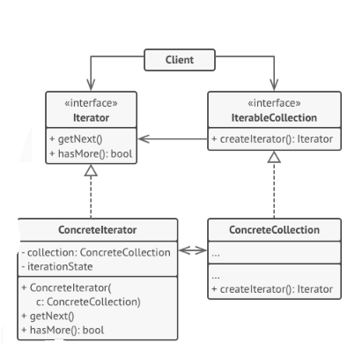
Iterator Pattern - Structure
3. The Collection interface declares one or multiple methods for getting iterators compatible with the collection. Note that the return type of the methods must be declared as the iterator interface so that the concrete collections can return various kinds of iterators.
1. The Iterator interface declares the operations required for traversing a collection: fetching the next element, retrieving the current position, restarting iteration, etc.
4. Concrete Collections return new instances of a particular concrete iterator class each time the client requests one
2. Concrete Iterators implement specific algorithms for traversing a collection. The iterator object should track the traversal progress on its own. This allows several iterators to traverse the same collection independently of each other.
5. The Client works with both collections and iterators via their interfaces. This way the client isn’t coupled to concrete classes, allowing you to use various collections and iterators with the same client code.

Slide 11
Iterator Pattern - Pseudocode
In this example, the Iterator pattern is used to walk through a special kind of collection which encapsulates access to Facebook’s social graph.
The collection provides several iterators that can traverse profiles in various ways.
The ‘friends’ iterator can be used to go over the friends of a given profile. The ‘colleagues’ iterator does the same, except it omits friends who don’t work at the same company as a target person.
Both iterators implement a common interface which allows clients to fetch profiles without diving into implementation details such as authentication and sending REST requests.
The client code isn’t coupled to concrete classes because it works with collections and iterators only through interfaces. If you decide to connect your app to a new social network, you simply need to provide new collection and iterator classes without changing the existing code.

Slide 12
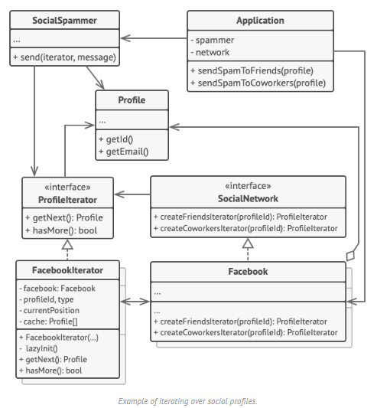

Slide 13
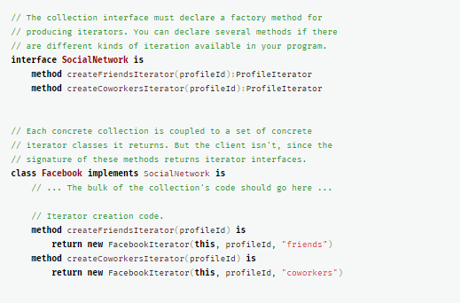
Iterator Pattern – Psuedocode (1)

Slide 14
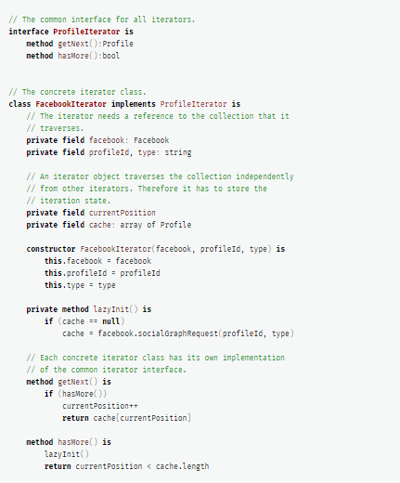
Iterator Pattern – Psuedocode (2)

Slide 15
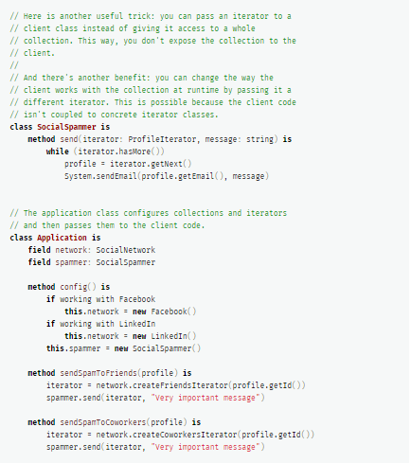
Iterator Pattern – Psuedocode (3)

Slide 16
Iterator Pattern - Pros
Single Responsibility Principle. You can clean up the client code and the collections by extracting bulky traversal algorithms into separate classes.
Open/Closed Principle. You can implement new types of collections and iterators and pass them to existing code without breaking anything.
You can iterate over the same collection in parallel because each iterator object contains its own iteration state.
For the same reason, you can delay an iteration and continue it when needed.

Slide 17
Iterator Pattern - Applicability
Use the Iterator pattern when your collection has a complex data structure under the hood, but you want to hide its complexity from clients (either for convenience or security reasons).
Use the pattern to reduce duplication of the traversal code across your app.
Use the Iterator when you want your code to be able to traverse different data structures or when types of these structures are unknown beforehand.

Slide 18
Iterator Pattern - Cons
Applying the pattern can be an overkill if your app only works with simple collections.
Using an iterator may be less efficient than going through elements of some specialized collections directly.

Slide 19
Observer Pattern - Intent
Observer is a behavioral design pattern that lets you define a subscription mechanism to notify multiple objects about any events that happen to the object they’re observing.

Slide 20
Observer Pattern - Problem
Imagine that you have two types of objects: a Customer and a Store. The customer is very interested in a particular brand of product (say, it’s a new model of the iPhone) which should become available in the store very soon.
The customer could visit the store every day and check product availability. But while the product is still en route, most of these trips would be pointless.

Slide 21
Observer Pattern - Problem
On the other hand, the store could send tons of emails (which might be considered spam) to all customers each time a new product becomes available. This would save some customers from endless trips to the store. At the same time, it’d upset other customers who aren’t interested in new products.
It looks like we’ve got a conflict. Either the customer wastes time checking product availability or the store wastes resources notifying the wrong customers.

Slide 22
Observer Pattern - Solution
The object that has some interesting state is often called subject, but since it’s also going to notify other objects about the changes to its state, we’ll call it publisher. All other objects that want to track changes to the publisher’s state are called subscribers.
The Observer pattern suggests that you add a subscription mechanism to the publisher class so individual objects can subscribe to or unsubscribe from a stream of events coming from that publisher.
In reality, this mechanism consists of 1) an array field for storing a list of references to subscriber objects and 2) several public methods which allow adding subscribers to and removing them from that list.

Slide 23
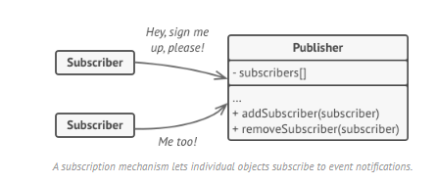
Observer Pattern

Slide 24
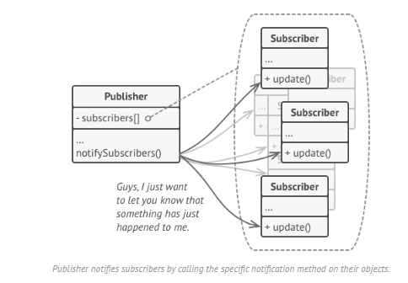

Slide 25
Observer Pattern - Solution
Now, whenever an important event happens to the publisher, it goes over its subscribers and calls the specific notification method on their objects.
Real apps might have dozens of different subscriber classes that are interested in tracking events of the same publisher class. You wouldn’t want to couple the publisher to all of those classes. Besides, you might not even know about some of them beforehand if your publisher class is supposed to be used by other people.
That’s why it’s crucial that all subscribers implement the same interface and that the publisher communicates with them only via that interface. This interface should declare the notification method along with a set of parameters that the publisher can use to pass some contextual data along with the notification.

Slide 26
Observer Pattern - Solution
If your app has several different types of publishers and you want to make your subscribers compatible with all of them, you can go even further and make all publishers follow the same interface. This interface would only need to describe a few subscription methods. The interface would allow subscribers to observe publishers’ states without coupling to their concrete classes.

Slide 27
Observer Pattern – Real World Analogy
If you subscribe to a newspaper or magazine, you no longer need to go to the store to check if the next issue is available. Instead, the publisher sends new issues directly to your mailbox right after publication or even in advance.
The publisher maintains a list of subscribers and knows which magazines they’re interested in. Subscribers can leave the list at any time when they wish to stop the publisher sending new magazine issues to them.

Slide 28
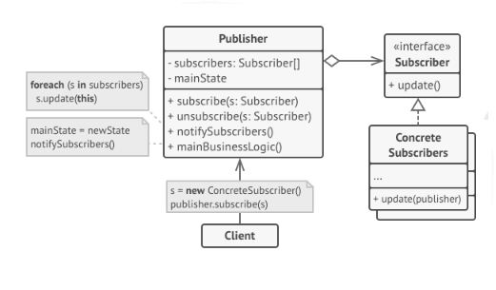
Observer Pattern - Structure
2. When a new event happens, the publisher goes over the subscription list and calls the notification method declared in the subscriber interface on each subscriber object.
1. The Publisher issues events of interest to other objects. Publishers contain a subscription infrastructure that lets new subscribers join and current subscribers leave the list.
3.The Subscriber interface declares the notification interface. Mostly it consists of a single update method. The method may have several parameters that let the publisher pass some event details along with the update.
5. The Client creates publisher and subscriber objects
separately and then registers subscribers for publisher
updates.
4. Concrete Subscribers perform some actions in response to notifications issued by
the publisher. All of these classes must implement the same interface so the publisher isn’t coupled to concrete classes.

Slide 29
Observer Pattern - Pseudocode
In this example, the Observer pattern lets the text editor object notify other service objects about changes in its state.
The list of subscribers is compiled dynamically: objects can start or stop listening to notifications at runtime, depending on the desired behavior of your app.
In this implementation, the editor class doesn’t maintain the subscription list by itself. It delegates this job to the special helper object devoted to just that. You could upgrade that object to serve as a centralized event dispatcher, letting any object act as a publisher.
Adding new subscribers to the program doesn’t require changes to existing publisher classes, as long as they work with all subscribers through the same interface.

Slide 30
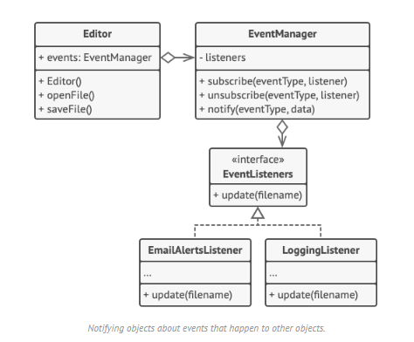
Observer Pattern - Pseudocode

Slide 31
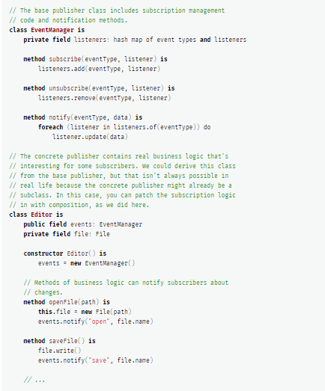
Observer Pattern – Pseudocode (1)

Slide 32
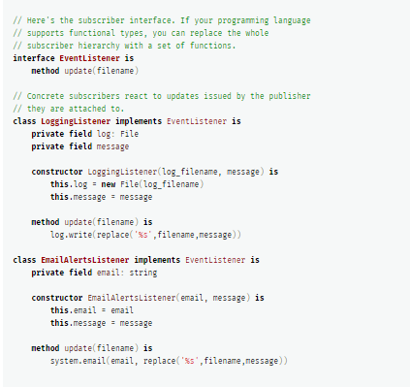
Observer Pattern – Pseudocode (2)

Slide 33
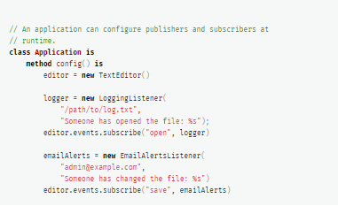
Observer Pattern – Pseudocode (3)

Slide 34
Observer Pattern - Applicability
Use the Observer pattern when changes to the state of one object may require changing other objects, and the actual set of objects is unknown beforehand or changes dynamically.
Use the pattern when some objects in your app must observe others, but only for a limited time or in specific cases.

Slide 35
Observer Pattern - Pros
Open/Closed Principle. You can introduce new subscriber classes without having to change the publisher’s code (and vice versa if there’s a publisher interface).
You can establish relations between objects at runtime.

Slide 36
Observer Pattern - Cons
Subscribers are notified in random order.

Slide 37
References
https://refactoring.guru/design-patterns

